Slide 1
78
Discrete Mathematics
Special Types of Graphs

Slide 2







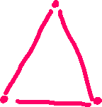





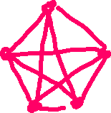












Slide 3




























Slide 4



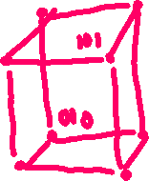























Slide 5



















Slide 6




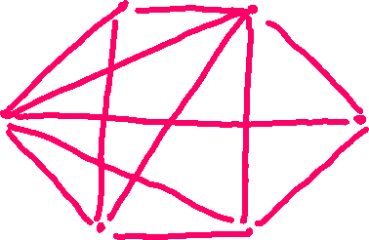


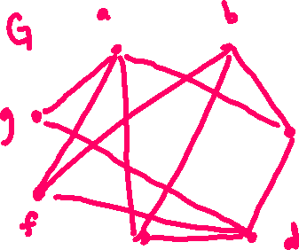





Slide 7


















Slide 8
Up Next…
Applications of Graphs

